Slide 1
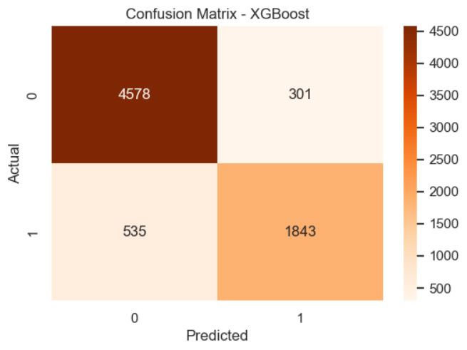
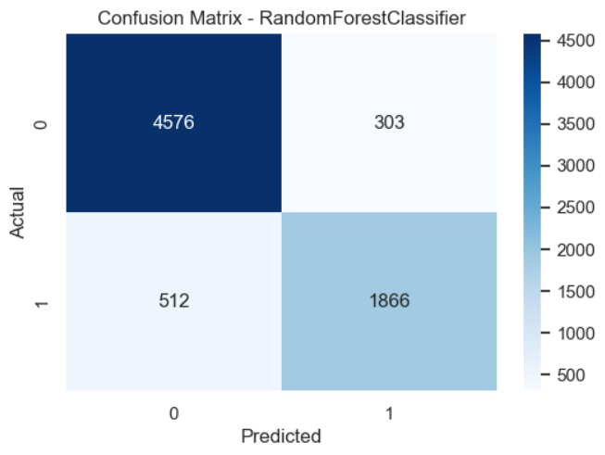
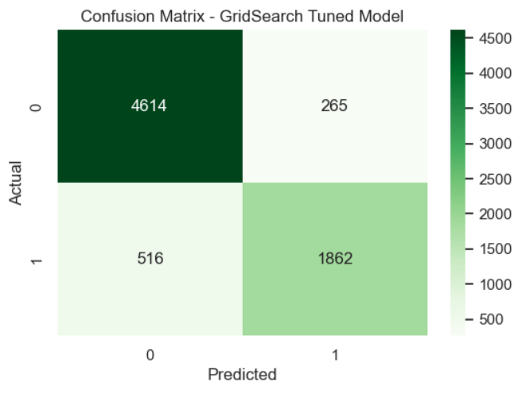
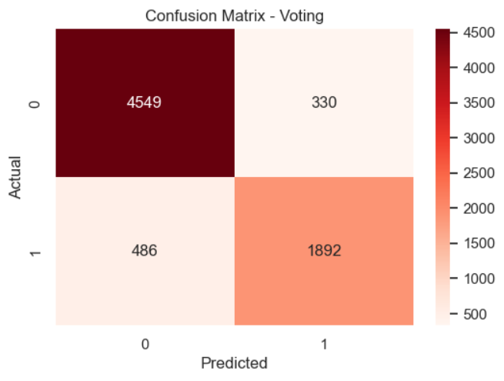
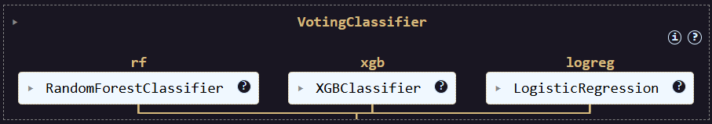
Predicting Hotel Booking Cancellations
Project Goal:
Solve a binary classification problem.
Predict whether a hotel booking will be canceled (1) or not (0).
Approach:
Conducted thorough preprocessing, outlier handling, and feature engineering.
Trained multiple models: Random Forest, XGBoost, Logistic Regression.
Combined them using a Voting Classifier for improved accuracy.

Slide 2
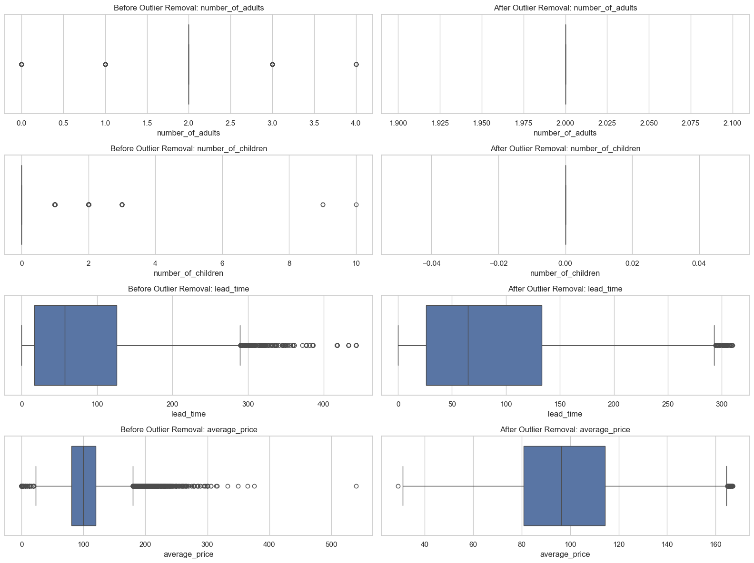
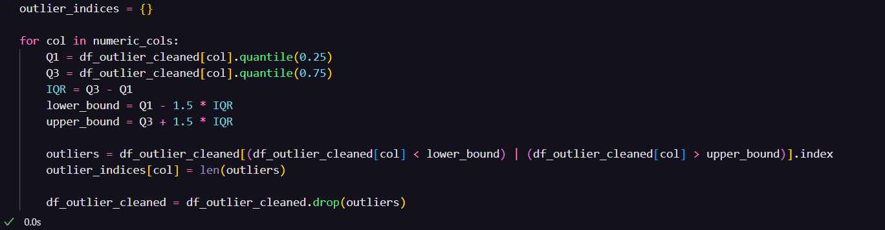
Data Cleaning and Preprocessing
Steps Taken:
Checked for null values and confirmed the dataset had no missing entries.
Removed extra whitespaces and standardized column names.
Converted date_of_reservation to datetime format.
Dropped irrelevant or constant columns.
Applied one-hot encoding to categorical features using pd.get_dummies().
Split features and target variable: X and y = booking_status.
Removed outliers using IQR on numeric columns.

Slide 3
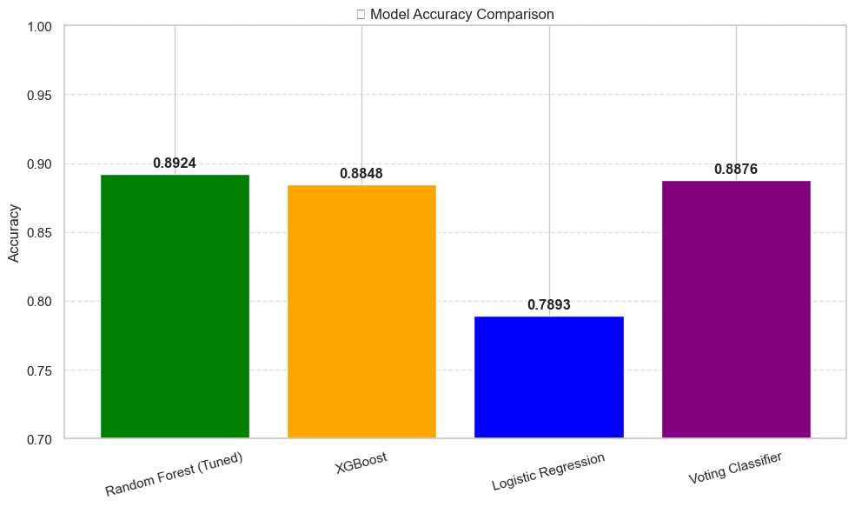
Feature Engineering & Modeling
Removed Booking_ID, reservation date
Engineered: dummy variables, stratified train-test split
Trained Random Forest, XGBoost, Logistic Regression
Combined them with a Voting Classifier

Slide 4
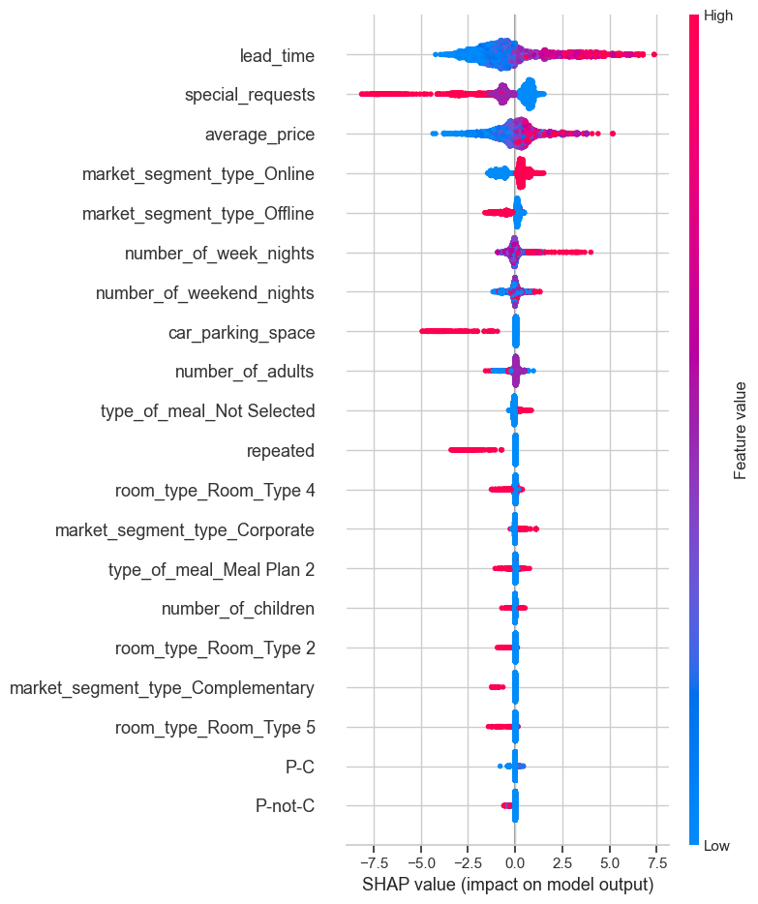
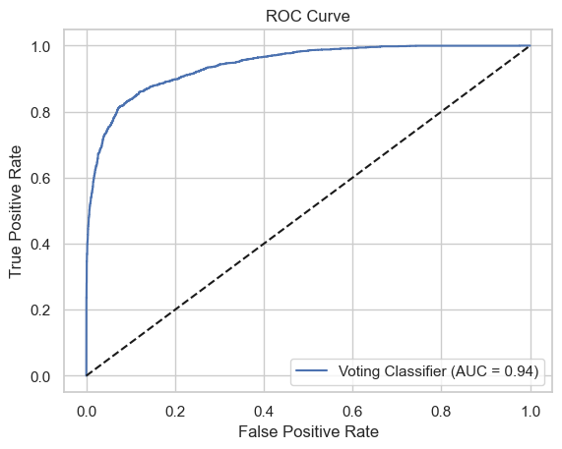
Performance Evaluation & SHAP Insights
Used accuracy, classification report, ROC curve
ROC AUC for VotingClassifier: ~94%
Applied SHAP to interpret feature impact

